Slide 1
Systems Analysis and Design
Prototyping and Interface Design

Slide 2
Topic & Structure of the lesson
Interface design
Input Design
Devices
Guidelines for form design
Identify the objectives of output design
List the guidelines in output design

Slide 3
Learning Outcomes
By the end of this lecture, YOU should be able to :
Discuss the objectives of input design
Identify the types of input design devices
List the guidelines of input design
Identify the objectives of output design
List the guidelines in output design

Slide 4
Key Terms you must be able to use
If you have mastered this topic, you should be able to use the following terms correctly in your assignments and exams:
Specialty forms
Logical Design
Physical Design
Detail Report
Exception Report
Summary Report

Slide 5
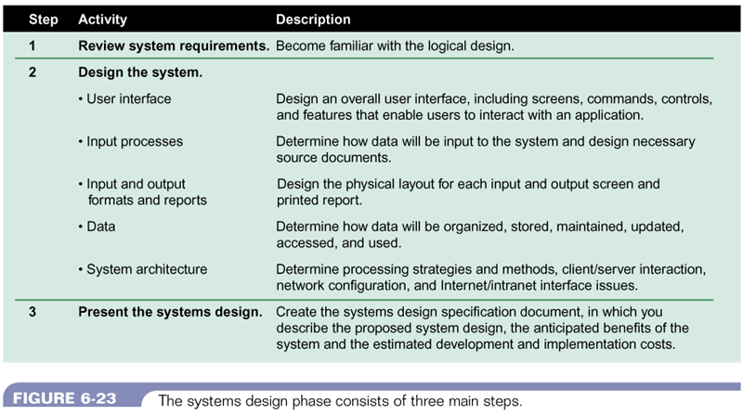
Three steps of the systems design phase
Figure 11-1 : Three steps of systems design phase
Systems Analysis & Design (4th Edition) – Shelly Cashman Series.

Slide 6
Logical Design
Is the logical or conceptual relationships among the components of the IS
Defines all
the outputs that must be produced by the system
the inputs needed by the system
the processes that must be performed by the system
Is concerned with what the system must accomplish.

Slide 7
Physical Design
A plan for the actual implementations of the logical design of the system
Describes the implementation of all components of the Information Systems
E.g. – describes actual processes of entering, verifying, and storing data; the physical layout of data files; the sorting procedures; the exact format of the reports

Slide 8
Difference between logical and physical design
LOGICAL DESIGN | PHYSICAL DESIGN
is concerned with what is required | is concerned with how the requirements are satisfied
what data will be input to the system | how the data is input
what processes must be performed | how is the data stored and processed
what information will be output | how the output is processed
what constraints must be met | how the constraints are met
is completed during the systems analysis phase | is completed during the systems design phase

Slide 9
Input Design Objectives
Ease of use
- forms and displays are straightforward and require no extra time for users to decipher.
Effectiveness
- input forms, input displays, and fill-in forms on the Web all serve specific purposes for users of the information system
Accuracy
- to design that ensures proper completion
Attractiveness
- implies that users will enjoy using input forms because of their appealing design.

Slide 10
Input Design Objectives
Simplicity
- keeping those same designs uncluttered in a manner that focuses the user’s attention.
Consistency
- all input forms, whether they are input displays or fill-in forms on the Web, group data similarly from one application to the next

Slide 11
Forms (Input)
preprinted or duplicated papers that require people to fill in responses in a standardized way
serve as source documents for data entry personnel or for input to e-commerce applications
A source document collects input data, triggers or authorizes an input action, and provides a record of the original transaction.

Slide 12
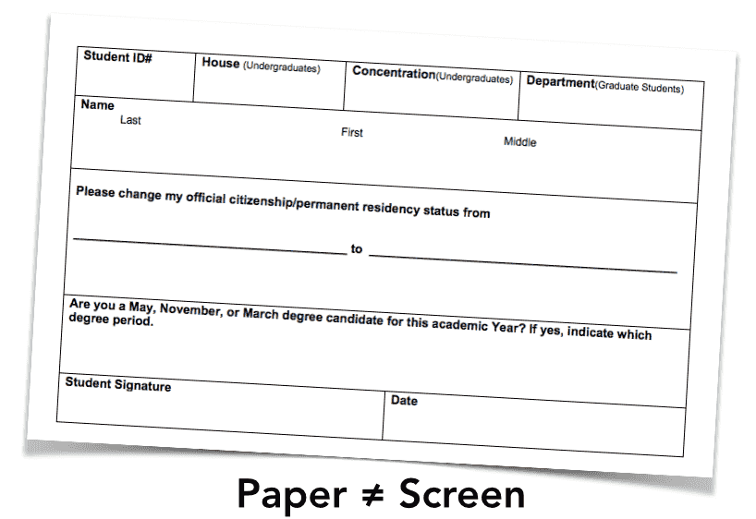

Slide 13
GUIDELINES FOR FORM DESIGN
Make forms easy to fill in
Ensure that forms meet the purpose for which they are designed
Design forms to ensure accurate completion
Keep forms attractive

Slide 14
I - Make forms easy to fill in
To reduce error, speed completion, and facilitate the entry of data, it is essential that forms be easy to fill in.
It is often possible to eliminate the process of transcribing data that are entered on a form into the system by using electronic submission.

Slide 15
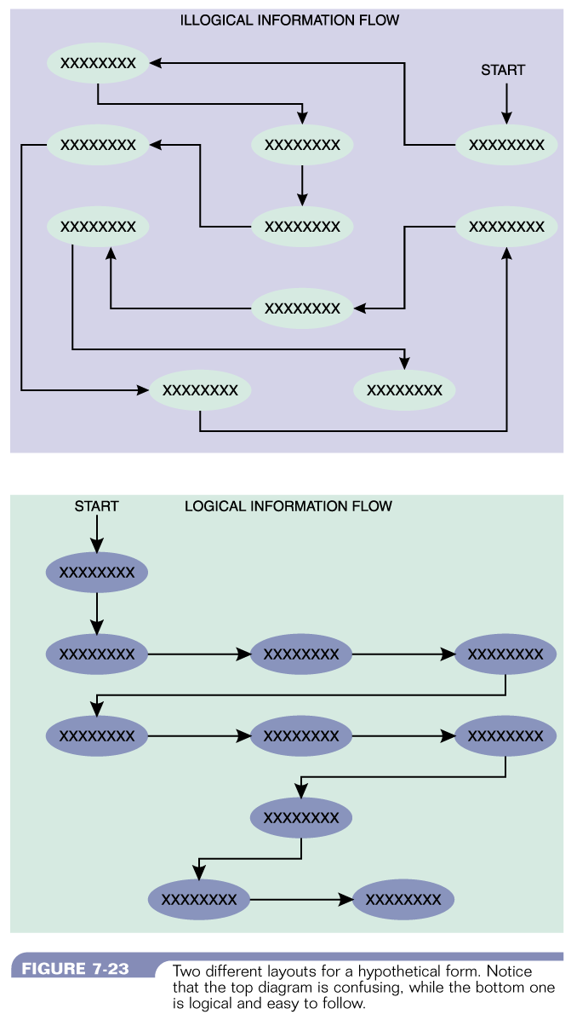
I - Make forms easy to fill in
Form Flow
Figure 11-11 : Illogical Information Flow
Systems Analysis & Design (4th Edition) – Shelly Cashman Series.
Figure 11-11 : Information Flow
Systems Analysis & Design (4th Edition) – Shelly Cashman Series.

Slide 16
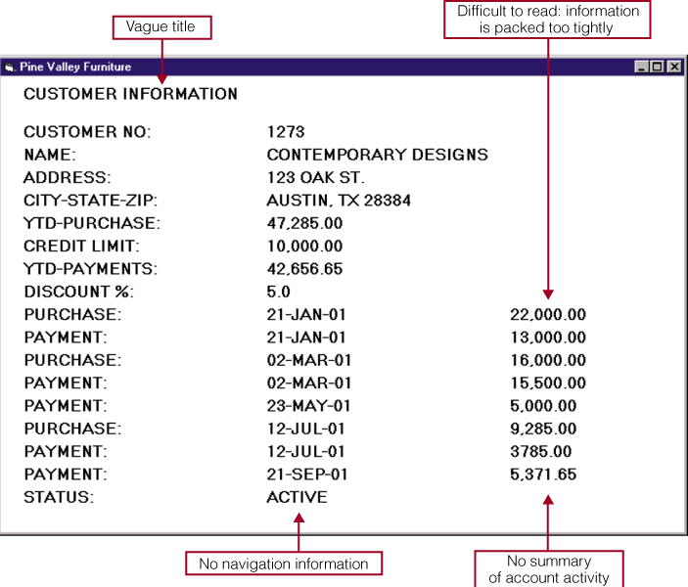
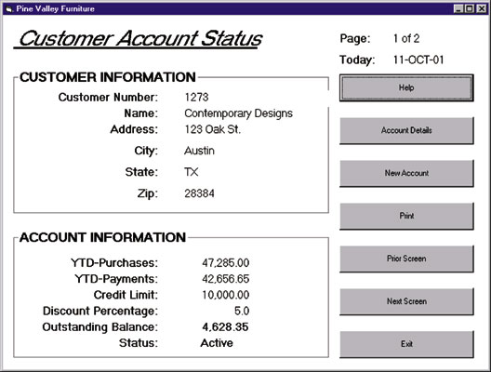
I - Make forms easy to fill in
Grouping of Information
Figure 11-11 : Illogical Grouping of Information
Systems Analysis & Design (4th Edition) – Shelly Cashman Series.
Figure 11-12 : Logical Grouping of Information
Systems Analysis & Design (4th Edition) – Shelly Cashman Series.

Slide 17
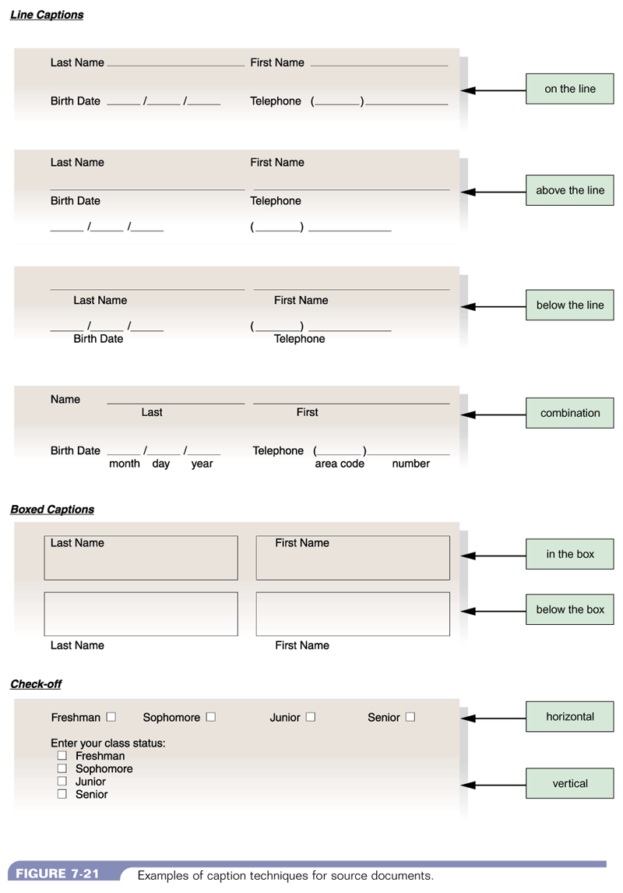
I - Make forms easy to fill in
Captions – Check-off
Figure 11-15 : Check-ff Captions
System Analysis and Design, 5/e - Kenneth E. Kendall & Julie E. Kendall

Slide 18
I - Make forms easy to fill in
Captions
Figure 11-13 : Line Captions
System Analysis and Design, 5/e - Kenneth E. Kendall & Julie E. Kendall

Slide 19

I - Make forms easy to fill in
Input Validation
Hints and Labels

Slide 20
II - Ensure that forms meet the purpose
Forms are created to serve one or more purposes in the recording, processing, storing, and retrieving of information for businesses.
forms which provide different information to different departments or users (specialty form)

Slide 21
III - Design form to ensure accurate completion
Error rates typically associated with collecting data will drop sharply when forms are designed to ensure accurate completion.
Design is important for ensuring that people do the right thing with the form whenever they use it.

Slide 22
IV - Keep forms attractive
forms should look uncluttered
appear organized and logical – provide enough space
follow a special order – name, street address, city, state, zip or postal code, country
Relevant data elements only- No unnecessary fields, layout & flow
suggestions
use different fonts for type within the same form
separate categories & subcategories with thick and thin lines

Slide 23
GUIDELINES FOR SCREEN DESIGN
Keep the screen simple
- The display should show only that which is necessary for the particular action being undertaken.
Keep the screen presentation consistent
- information that logically belongs together should be consistently grouped together. For example, name and address go together, not name and zip code.
Facilitate user movement among screens
- Web-based forms facilitate movement with the use of hyperlinks to other relevant Web pages. Also scrolling using arrows, context- sensitive pop-up windows, or onscreen dialog.
Create an attractive screen
- Displays should draw users into them and hold their attention.

Slide 24
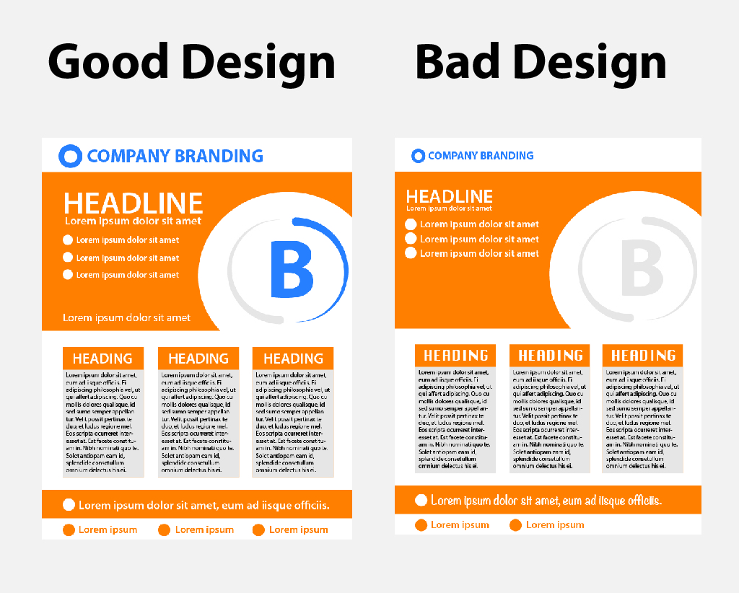

Slide 25
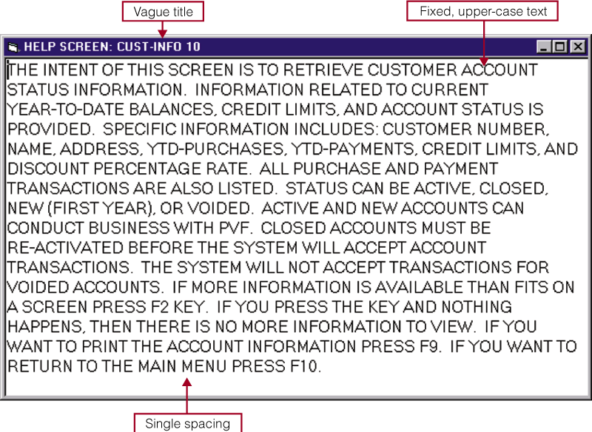
What it should not be
Figure 11-17 : Unattractive screen design
Systems Analysis & Design (4th Edition) – Shelly Cashman Series.

Slide 26
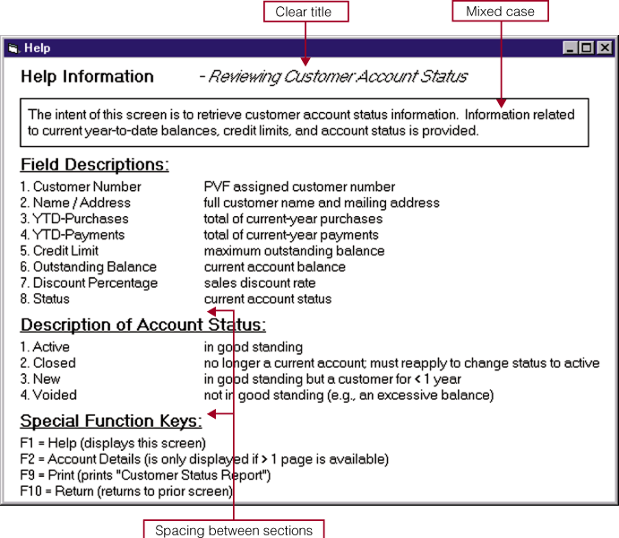
What it should be
Figure 11-18 : Attractive Screen Design
Systems Analysis & Design (4th Edition) – Shelly Cashman Series.

Slide 27
Output Design Objectives
Designing output to serve a specific purpose
Making output meaningful to the user
Delivering the appropriate quantity of output
Providing appropriate output distribution
Providing output on time
Choosing the most effective output method

Slide 28
Guidelines in Output Design
IDENTIFY:
Who is using the output?
What should the output be?
When should the output be?
How should the output be presented?
How much will it cost?

Slide 29
Guidelines in Output Design
Report Design Principles
Must be attractive, professional, and easy to read
Should provide totals and subtotals for numeric fields
Analyst must consider design features such as report headers and footers, page headers and footers, column headings and alignment, column spacing, field order, and grouping of detail lines

Slide 30
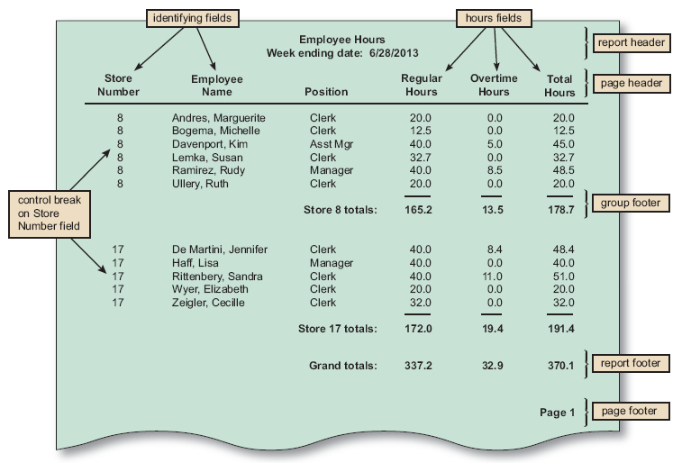
Guidelines in Output Design
FIGURE 8-20 The Employee Hours report is a detail report with control breaks, subtotals, and grand totals. Notice that a report header identifies the report, a page header contains column headings, a group footer contains subtotals for each store, a report footer contains grand totals, and a page footer identifies the page number

Slide 31
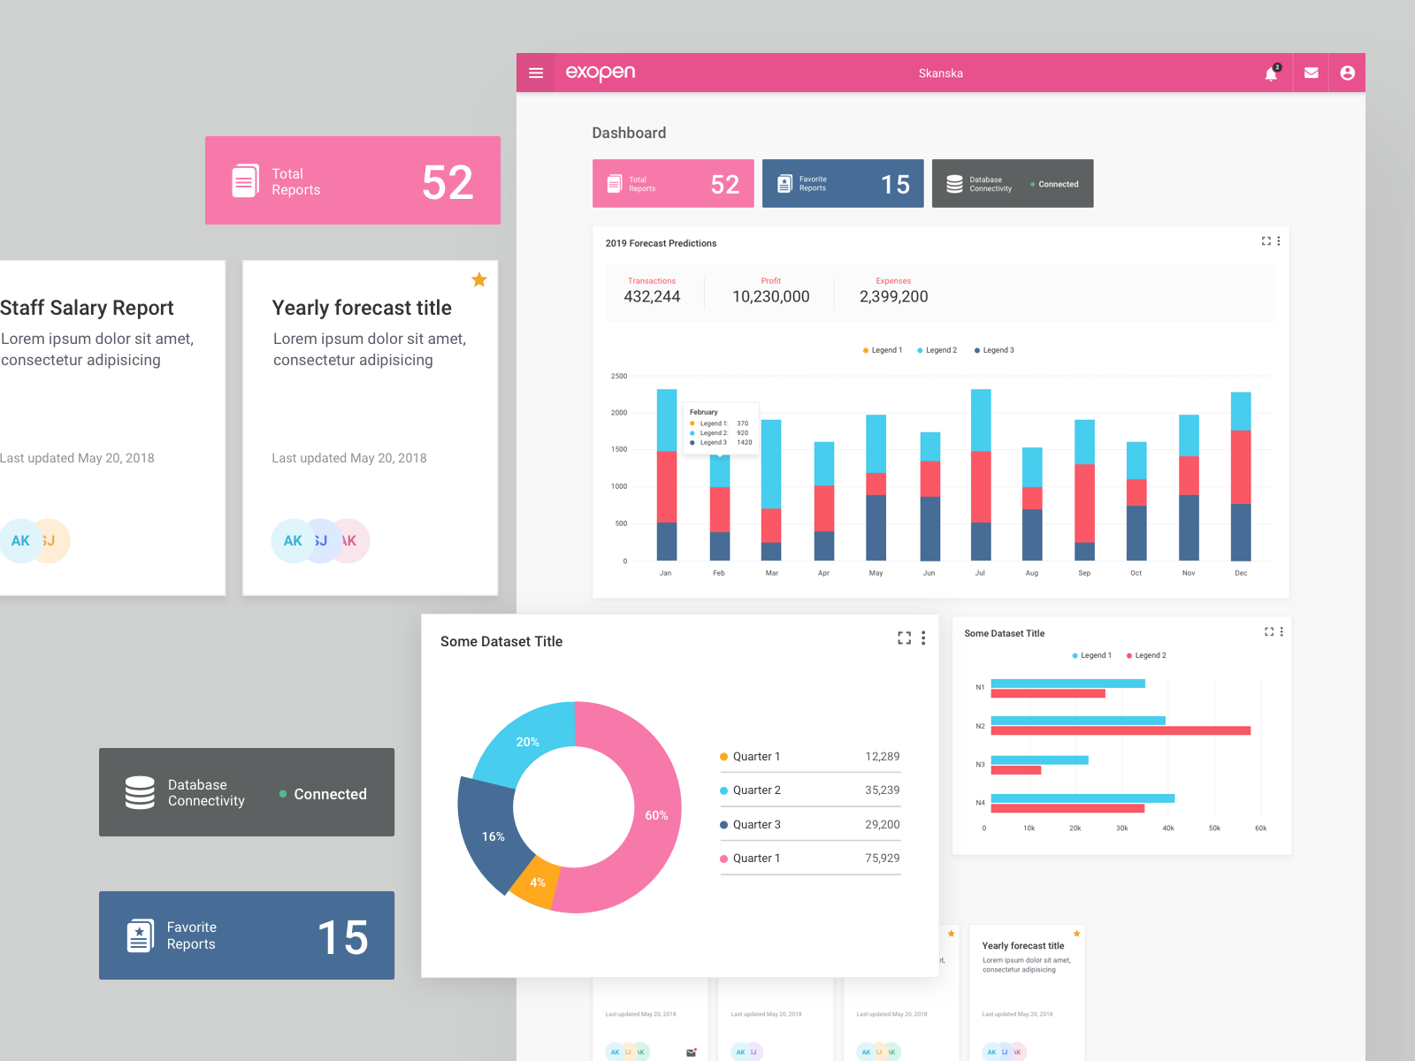

Slide 32
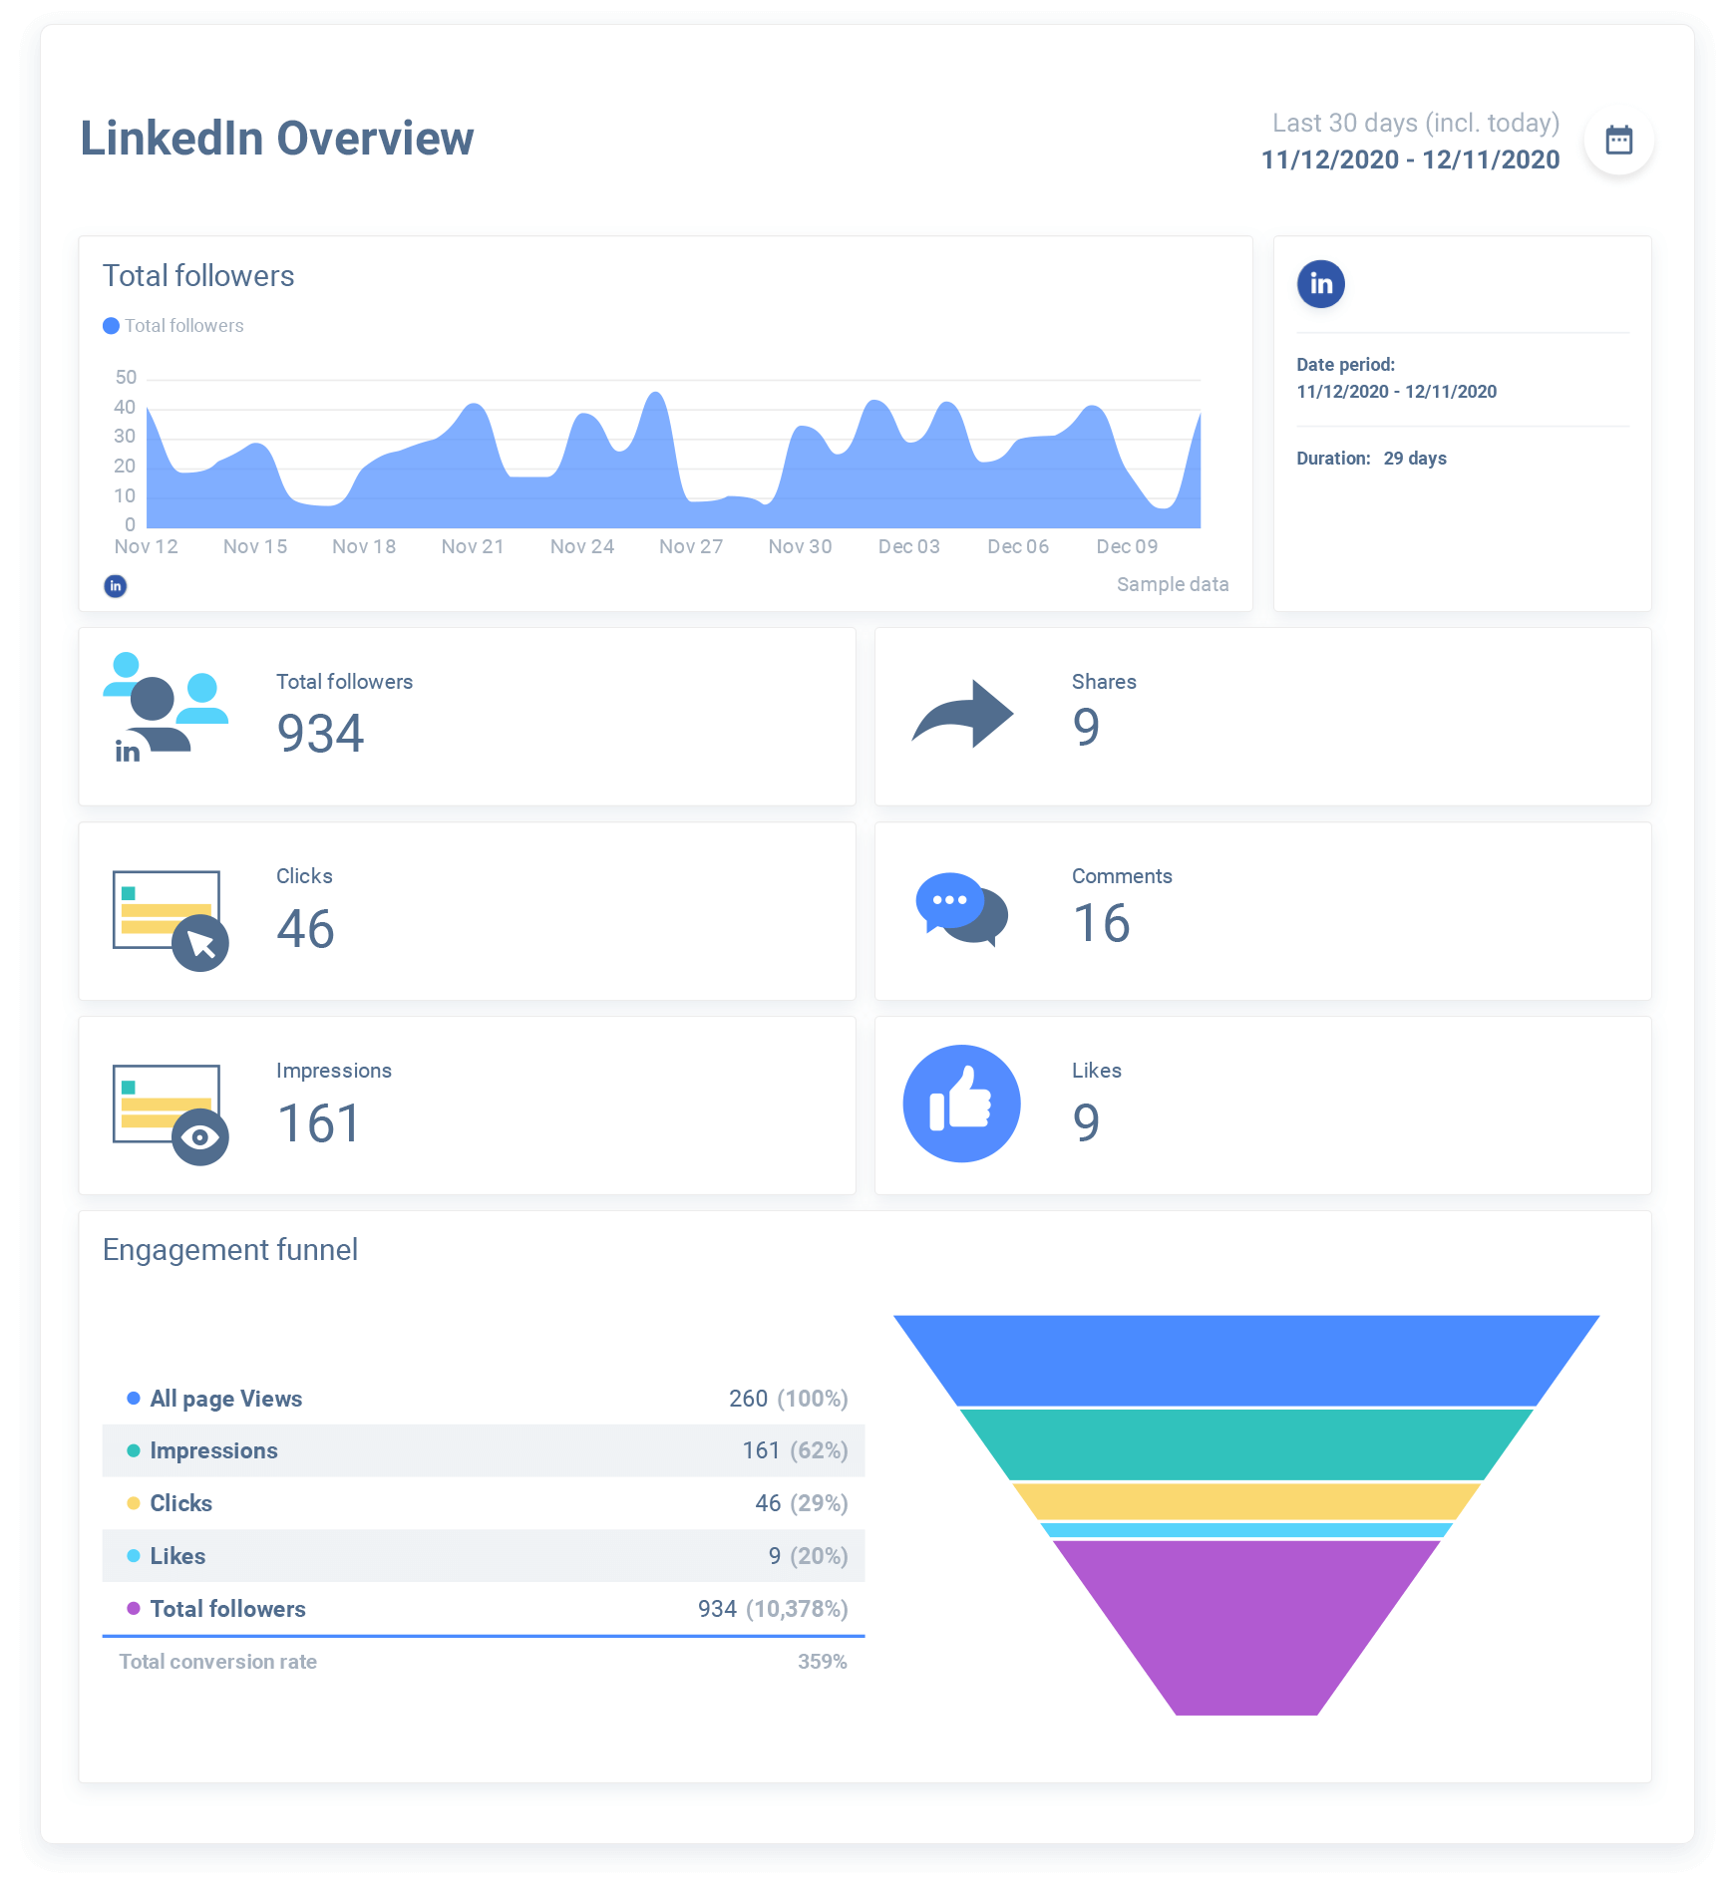

Slide 33
Guidelines in Output Design
Report Design Principles
Page Headers and Footers
Every page should have a report header and a report footer
Header includes the column headings that identify the data. The headings should be short but descriptive
Footer used to display the report title and the page number
Repeating Fields
The best advice is to ask users what they think and be guided accordingly
Consistent Design
Look and feel are important to users, so reports should be uniform and consistent

Slide 34
Considerations in Output Design
Main requirements in output design is that it meets the user requirements
Major function of output is to convey the information required by the user.
Therefore, the layout and design of the output is important.

Slide 35
Types of Report
Types of Reports
DETAIL REPORTS
Produces one or more lines of output for each record processed
Can be quite lengthy
A better alternative might be an exception report
EXCEPTION REPORTS
Displays only those records that meet a specific condition or exceptions
Useful when the user wants information only on records that might require action, but does not need to know the details
SUMMARY REPORTS
Upper-level managers often want to see total figures and do not need supporting details

Slide 36
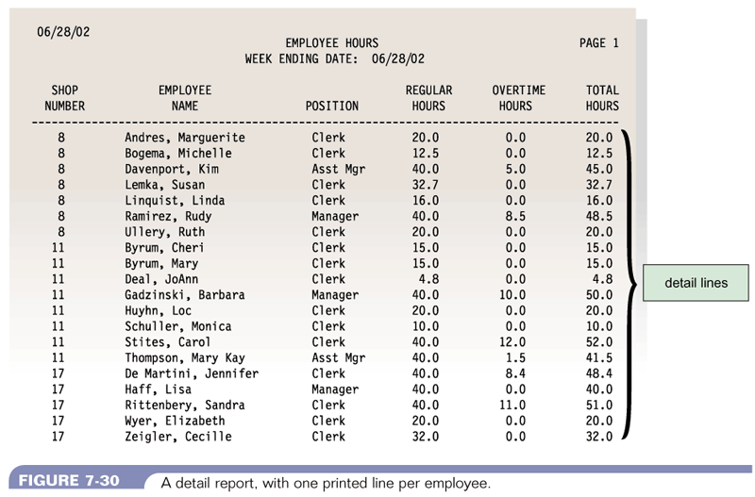
Types of Report - Detail Report
Figure 11-4 : A detail report with one printed line per employee
Systems Analysis & Design (4th Edition) – Shelly Cashman Series.

Slide 37
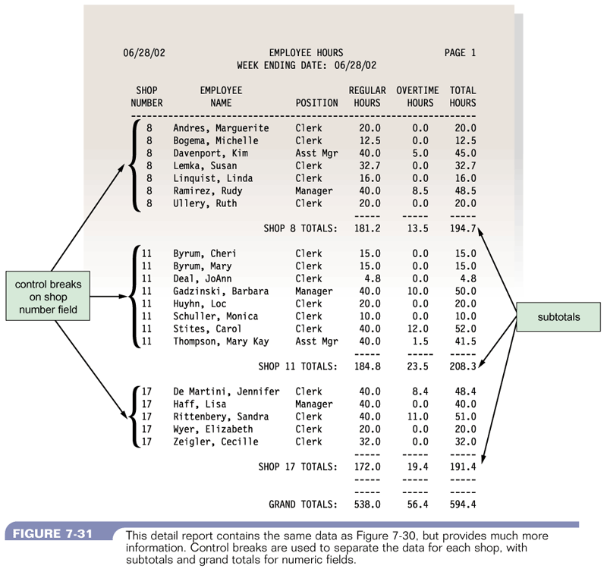
Detail Report
Figure 11-5 : A detail report with more information and using control break
Systems Analysis & Design (4th Edition) – Shelly Cashman Series.

Slide 38
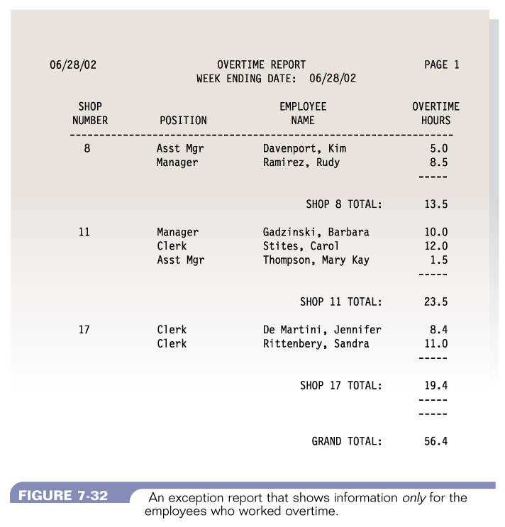
Exception Report
Figure 11-6 : A n exception report that shows information only for the employees who worked overtime
Systems Analysis & Design (4th Edition) – Shelly Cashman Series.

Slide 39
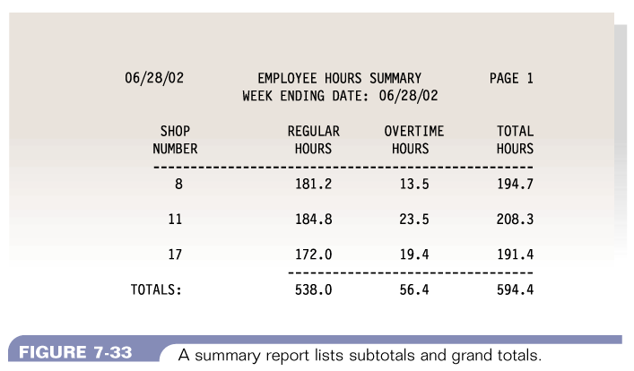
Summary Report
Figure 11-7 : A summary report lists subtotals and grand totals
Systems Analysis & Design (4th Edition) – Shelly Cashman Series.

Slide 40
Summary of Main Teaching Points
Output Design
Systems design
User Interface design

Slide 41
Question and Answer Session
Q & A

Slide 42
Next Session
Implementation
Coding Standards
Types of testing
Test plan

